Slide 1

Language Modeling
Introduction to N-grams
IP disclosure: Content borrowed from J&M 3rd edition and Raymond Mooney.

Slide 2
Approximating Natural Language Words
Zero-order approximation: letter sequences are independent of each other and have a uniform distribution:
    xfoml rxkhrjffjuj zlpwcwkcy ffjeyvkcqsghyd

Slide 3
Approximating Natural Language Words
First-order approximation: letters are independent, but occur with the frequencies of English text:
  ocro hli rgwr nmielwis eu ll nbnesebya th eei alhenhtppa oobttva nah

Slide 4
Approximating Natural Language Words
second-order approximation: the probability that a letter appears depends on the previous letter
  on ie antsoutinys are t inctore st bes deamy achin d ilonasive tucoowe at teasonare fuzo tizin andy tobe seace ctisbe

Slide 5
Approximating Natural Language Words
third-order approximation: the probability that a certain letter appears depends on the two previous letters
  in no ist lat whey cratict froure birs grocid pondenome of demonstures of the reptagin is regoactiona of cre

Slide 6
Approximating Natural Language Words
Higher frequency trigrams for different languages:
  English: THE, ING, ENT, ION
  German: EIN, ICH, DEN, DER
  French: ENT, QUE, LES, ION
  Italian: CHE, ERE, ZIO, DEL
  Spanish: QUE, EST, ARA, ADO

Slide 7
Language Models
  LM: an abstract representation of a (natural) language phenomenon
  Claim: A useful part of the knowledge needed to allow letter/word predictions can be captured using simple statistical techniques.
  Compute:
    probability of a sequence
    likelihood of letters/words co-occurring
  Why would we want to do this?
    Rank the likelihood of sequences containing various alternative hypotheses
    Assess the likelihood of a hypothesis

Slide 8
Use of Language Models
Speech Recognition
Handwriting recognition
Spelling correction
Machine translation systems
Optical character recognizers
Prediction of language impairments

Slide 9
Use of Language Models
Speech Recognition
  “How to wreck a nice beach you sing calm incense”
OCR/Handwriting recognition
Spelling correction
Completion prediction
Machine translation systems
Prediction of language impairments

Slide 10
OCR/Handwriting Recognition
Assume a note is given to a bank teller, which the teller reads as I have a gub. (cf. Woody Allen)
NLP to the rescue ….
  gub is not a word
  gun, gum, Gus, and gull are words, but gun has a higher probability in the context of a bank

Slide 11
Real Word Spelling Errors
They are leaving in about fifteen minuets to go to her house.
The study was conducted mainly be John Black.
Hopefully, all with continue smoothly in my absence.
Can they lave him my messages?
I need to notified the bank of….
He is trying to fine out.

Slide 12
For Spell Checkers
Collect list of commonly substituted words
  piece/peace, whether/weather, their/there ...
Example:
“On Tuesday, the whether …’’
“On Tuesday, the weather …”

Slide 13
Completion Prediction
A language model also supports predicting the completion of a sentence.
  Please turn off your cell _____
  Your program does not ______
Predictive text input systems can guess what you are typing and give choices on how to complete it.

Slide 14
Other Applications
Machine translation
  More likely sentences are probably better translations.
Generation
  More likely sentences are probably better NL generations.
Prediction of language impairment
  Unlikely utterances could be due to an LI
Summarization
QA
….

Slide 15
Probabilistic Language Modeling
Goal: compute the probability of a sentence or sequence of words:
  P(W) = P(w₁,w₂,w₃,w₄,w₅…w_{n})
Related task: probability of an upcoming word:
  P(w₅|w₁,w₂,w₃,w₄)
A model that computes either of these:
  P(W) or P(w_{n}|w₁,w₂…w_{n-1}) is called a language model.
Better: the grammar But language model or LM is standard

Slide 16
How to compute P(W)
How to compute this joint probability:
  P(its, water, is, so, transparent, that)
Intuition: let’s rely on the Chain Rule of Probability

Slide 17
Reminder: The Chain Rule
Recall the definition of conditional probabilities
  p(B|A) = P(A,B)/P(A) Rewriting: P(A,B) = P(A)P(B|A)
More variables:
  P(A,B,C,D) = P(A)P(B|A)P(C|A,B)P(D|A,B,C)
The Chain Rule in General
P(x₁,x₂,x₃,…,x_{n}) = P(x₁)P(x₂|x₁)P(x₃|x₁,x₂)…P(x_{n}|x₁,…,x_{n-1})

Slide 18
The Chain Rule applied to compute joint probability of words in sentence
P(“its water is so transparent”) =
P(its) × P(water|its) × P(is|its water)
× P(so|its water is) × P(transparent|its water is so)

Slide 19
Relative Frequencies and Conditional Probabilities
Relative word frequencies are better than equal probabilities for all words
  In a corpus with 10K word types, each word would have P(w) = 1/10K
  Counterintuitive
Conditional probability more useful than individual relative word frequencies
  dog may be relatively rare in a corpus
  But if we see barking, P(dog|barking) may be very large

Slide 20
How to estimate these probabilities
Could we just count and divide?
What can possibly be wrong with this?

Slide 21

Markov Assumption
Simplifying assumption:
Or maybe
Andrei Markov

Slide 22
Markov Assumption
In other words, we approximate each component in the product

Slide 23
Simplest case: Unigram model
Some automatically generated sentences from a unigram model
fifth, an, of, futures, the, an, incorporated, a, a, the, inflation, most, dollars, quarter, in, is, mass
thrift, did, eighty, said, hard, 'm, july, bullish
that, or, limited, the

Slide 24
Bigram model
Condition on the previous word:
texaco, rose, one, in, this, issue, is, pursuing, growth, in, a, boiler, house, said, mr., gurria, mexico, 's, motion, control, proposal, without, permission, from, five, hundred, fifty, five, yen
outside, new, car, parking, lot, of, the, agreement, reached
this, would, be, a, record, november

Slide 25
N-gram models
We can extend to trigrams, 4-grams, 5-grams
In general this is an insufficient model of language
  because language has long-distance dependencies:
  “The computer which I had just put into the machine room on the fifth floor crashed.”
But we can often get away with N-gram models

Slide 26
Language Modeling
Estimating N-gram Probabilities

Slide 27
Estimating bigram probabilities
The Maximum Likelihood Estimate

Slide 28

An example
<s> I am Sam </s>
<s> Sam I am </s>
<s> I do not like green eggs and ham </s>

Slide 29
More examples:
Berkeley Restaurant Project sentences
can you tell me about any good cantonese restaurants close by
mid priced thai food is what i’m looking for
tell me about chez panisse
can you give me a listing of the kinds of food that are available
i’m looking for a good place to eat breakfast
when is caffe venezia open during the day

Slide 30
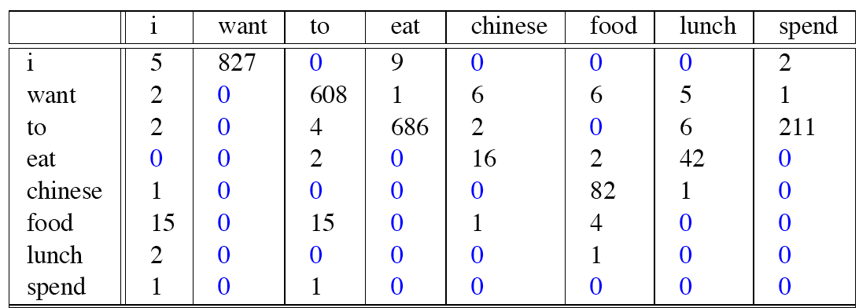
Raw bigram counts
Out of 9222 sentences

Slide 31
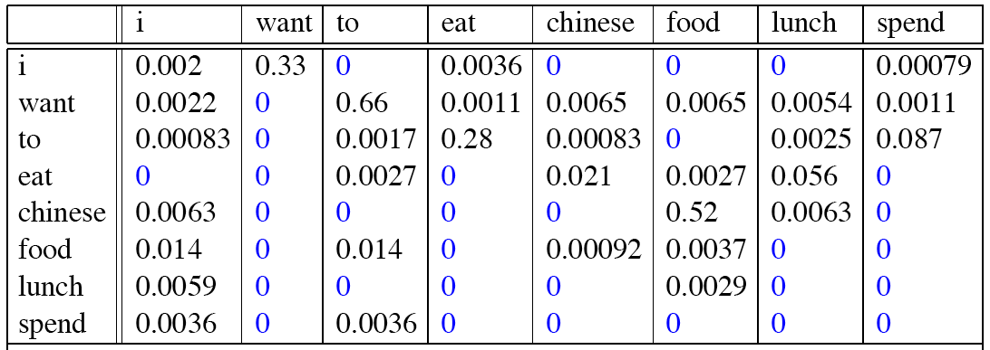
Raw bigram probabilities
Normalize by unigrams:
Result:

Slide 32
Bigram estimates of sentence probabilities
P(<s> I want english food </s>) =
P(I|<s>)
× P(want|I)
× P(english|want)
× P(food|english)
× P(</s>|food)
= .000031

Slide 33
What kinds of knowledge?
P(english|want) = .0011
P(chinese|want) = .0065
P(to|want) = .66
P(eat | to) = .28
P(food | to) = 0
P(want | spend) = 0
P (i | <s>) = .25

Slide 34
Practical Issues
We do everything in log space
  Avoid underflow
  (also adding is faster than multiplying)

Slide 35
Language Modeling Toolkits
SRILM
  http://www.speech.sri.com/projects/srilm/
KenLM
  https://kheafield.com/code/kenlm/

Slide 36
Google N-Gram Release, August 2006
…

Slide 37
Google N-Gram Release
serve as the incoming 92
serve as the incubator 99
serve as the independent 794
serve as the index 223
serve as the indication 72
serve as the indicator 120
serve as the indicators 45
serve as the indispensable 111
serve as the indispensible 40
serve as the individual 234
http://googleresearch.blogspot.com/2006/08/all-our-n-gram-are-belong-to-you.html

Slide 38
Google Book N-grams
http://ngrams.googlelabs.com/

Slide 39
Language Modeling
Evaluation and Perplexity

Slide 40
Evaluation: How good is our model?
Does our language model prefer good sentences to bad ones?
  Assign higher probability to “real” or “frequently observed” sentences
    Than “ungrammatical” or “rarely observed” sentences?
We train parameters of our model on a training set.
We test the model’s performance on data we haven’t seen.
  A test set is an unseen dataset that is different from our training set, totally unused.
  An evaluation metric tells us how well our model does on the test set.

Slide 41
Extrinsic evaluation of N-gram models
Best evaluation for comparing models A and B
  Put each model in a task
    spelling corrector, speech recognizer, MT system
  Run the task, get an accuracy for A and for B
    How many misspelled words corrected properly
    How many words translated correctly
  Compare accuracy for A and B

Slide 42
Difficulty of extrinsic (in-vivo) evaluation of N-gram models
Extrinsic evaluation
  Time-consuming; can take days or weeks
So
  Sometimes use intrinsic evaluation: perplexity
  Bad approximation
    unless the test data looks just like the training data
    So generally only useful in pilot experiments
  But is helpful to think about.

Slide 43
Intuition of Perplexity
mushrooms 0.1
pepperoni 0.1
anchovies 0.01
….
fried rice 0.0001
….
and 1e-100
The Shannon Game:
  How well can we predict the next word?
  Unigrams are terrible at this game. (Why?)
A better model of a text
  is one which assigns a higher probability to the word that actually occurs
I always order pizza with cheese and ____
The 33rd President of the US was ____
I saw a ____

Slide 44
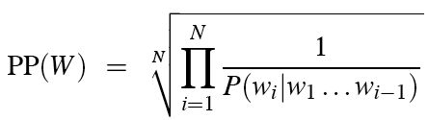
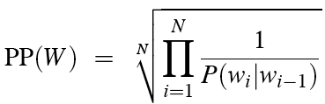
Perplexity
The best language model is one that best predicts an unseen test set
  Gives the highest P(sentence)
Perplexity is the inverse probability of the test set, normalized by the number of words:
Chain rule:
For bigrams:
Minimizing perplexity is the same as maximizing probability

Slide 45
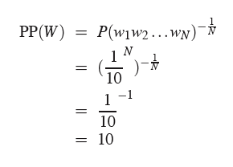
Perplexity as branching factor
Let’s suppose a sentence consisting of random digits
What is the perplexity of this sentence according to a model that assigns P=1/10 to each digit?

Slide 46
Lower perplexity = better model
Training 38 million words, test 1.5 million words, WSJ
N-gram Order | Unigram | Bigram | Trigram
Perplexity | 962 | 170 | 109

Slide 47
Language Modeling
Generalization and zeros

Slide 48
The Shannon Visualization Method
Choose a random bigram
(<s>, w) according to its probability
Now choose a random bigram (w, x) according to its probability
And so on until we choose </s>
Then string the words together
<s> I
I want
want to
to eat
eat Chinese
Chinese food
food </s>
I want to eat Chinese food

Slide 49
Approximating Shakespeare

Slide 50
Shakespeare as corpus
N=884,647 tokens, V=29,066
Shakespeare produced 300,000 bigram types out of V²= 844 million possible bigrams.
  So 99.96% of the possible bigrams were never seen (have zero entries in the table)
Quadrigrams worse: What's coming out looks like Shakespeare because it is Shakespeare

Slide 51
The wall street journal is not shakespeare (no offense)

Slide 52
Can you guess the author of these random 3-gram sentences?
They also point to ninety nine point six billion dollars from two hundred four oh six three percent of the rates of interest stores as Mexico and gram Brazil on market conditions
This shall forbid it should be branded, if renown made it empty.
“You are uniformly charming!” cried he, with a smile of associating and now and then I bowed and they perceived a chaise and four to wish for.

Slide 53
The perils of overfitting
N-grams only work well for word prediction if the test corpus looks like the training corpus
  In real life, it often doesn’t
  We need to train robust models that generalize!
  One kind of generalization: Zeros!
    Things that don’t ever occur in the training set
      But occur in the test set

Slide 54
The perils of overfitting
Zipf’s Law:
  A small number of events occur with high frequency
  A large number of events occur with low frequency
  You can quickly collect statistics on the high frequency events
  You might have to wait an arbitrarily long time to get valid statistics on low frequency events
P(“And nothing but the truth”) ≈ 0.001
P(“And nuts sing on the roof”) ≈ 0

Slide 55
Zeros
Training set:
  … denied the allegations
  … denied the reports
  … denied the claims
  … denied the request
  P(“offer” | denied the) = 0
Test set
  … denied the offer
  … denied the loan

Slide 56
Zero probability bigrams
Bigrams with zero probability
  mean that we will assign 0 probability to the test set!
And hence we cannot compute perplexity (can’t divide by 0)!

Slide 57
Language Modeling
Smoothing: Add-one (Laplace) smoothing

Slide 58
The intuition of smoothing (from Dan Klein)
When we have sparse statistics:
Steal probability mass to generalize better
P(w | denied the)
3 allegations
2 reports
1 claims
1 request
7 total
allegations
attack
man
reports
outcome
…
claims
request
P(w | denied the)
2.5 allegations
1.5 reports
0.5 claims
0.5 request
2 other
7 total
allegations
allegations
attack
man
outcome
reports
…
claims
request

Slide 59
Add-one estimation
Also called Laplace smoothing
Pretend we saw each word one more time than we did
Just add one to all the counts!
MLE estimate:
Add-1 estimate:

Slide 60
Maximum Likelihood Estimates
The maximum likelihood estimate
  of some parameter of a model M from a training set T maximizes the likelihood of the training set T given the model M
Suppose the word “bagel” occurs 400 times in a corpus of a million words
What is the probability that a random word from some other text will be “bagel”?
MLE estimate is 400/1,000,000 = .0004
This may be a bad estimate for some other corpus
  But it is the estimate that makes it most likely that “bagel” will occur 400 times in a million word corpus.

Slide 61
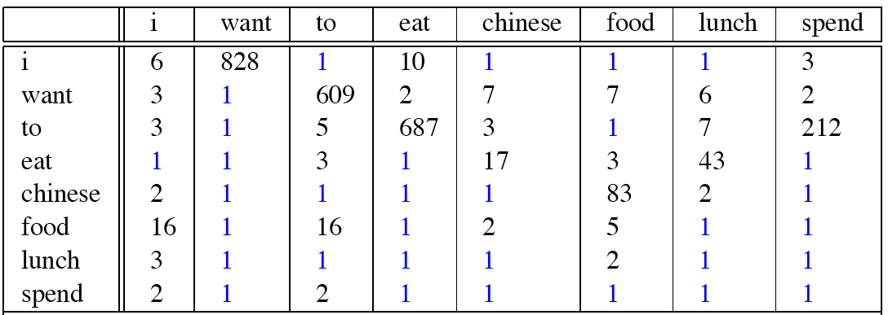
Berkeley Restaurant Corpus: Laplace smoothed bigram counts

Slide 62

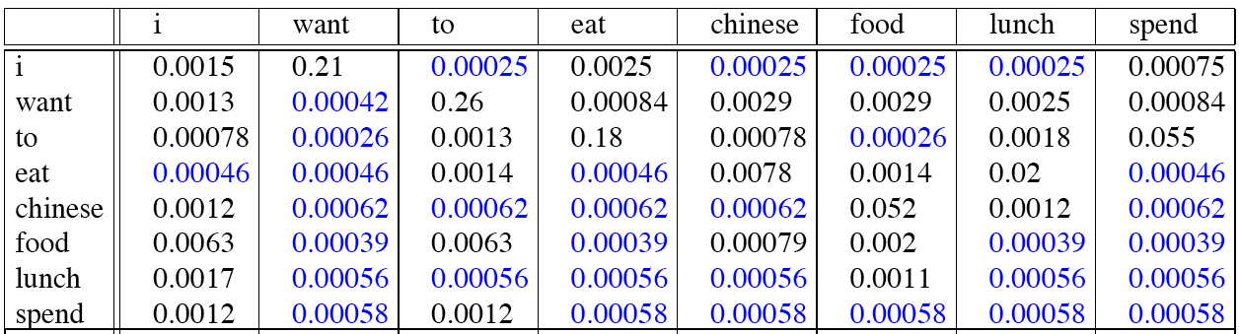
Laplace-smoothed bigrams

Slide 63
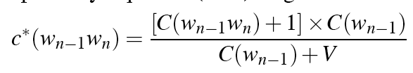
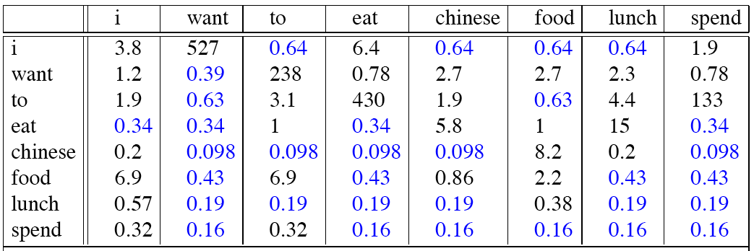
Reconstituted counts

Slide 64
Compare with raw bigram counts
Notes:
C(want to) went from 608 to 238, P(to|want) from .66 to .26!
Discount d= c*/c
d for “chinese food” =.10!!! A 10x reduction

Slide 65
Add-1 estimation is a blunt instrument
So add-1 isn’t used for N-grams:
  We’ll see better methods
But add-1 is used to smooth other NLP models
  For text classification
  In domains where the number of zeros isn’t so huge.

Slide 66
Language Modeling
Interpolation, Backoff, and Web-Scale LMs

Slide 67
Backoff and Interpolation
Sometimes it helps to use less context
  Condition on less context for contexts you haven’t learned much about
Backoff:
  use trigram if you have good evidence,
  otherwise bigram, otherwise unigram
Interpolation:
  mix unigram, bigram, trigram
Interpolation works better

Slide 68
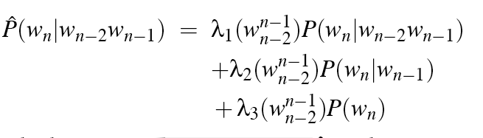
Linear Interpolation
Simple interpolation
Lambdas conditional on context:

Slide 69
How to set the lambdas?
Use a held-out corpus
Choose λs to maximize the probability of held-out data:
  Fix the N-gram probabilities (on the training data)
  Then search for λs that give largest probability to held-out set:
Training Data
Held-Out Data
Test
Data

Slide 70
Unknown words: Open versus closed vocabulary tasks
If we know all the words in advanced
  Vocabulary V is fixed
  Closed vocabulary task
Often we don’t know this
  Out Of Vocabulary = OOV words
  Open vocabulary task
Instead: create an unknown word token <UNK>
  Training of <UNK> probabilities
    Create a fixed lexicon L of size V
    At text normalization phase, any training word not in L changed to <UNK>
    Now we train its probabilities like a normal word
  At decoding time
    If text input: Use UNK probabilities for any word not in training

Slide 71
Huge web-scale n-grams
How to deal with, e.g., Google N-gram corpus
Pruning
  Only store N-grams with count > threshold.
    Remove singletons of higher-order n-grams
  Entropy-based pruning
Efficiency
  Efficient data structures like tries
  Store words as indexes, not strings
    Use Huffman coding to fit large numbers of words into two bytes
  Quantize probabilities (4-8 bits instead of 8-byte float)

Slide 72
Smoothing for Web-scale N-grams
“Stupid backoff” (Brants et al. 2007)
No discounting, just use relative frequencies

Slide 73
N-gram Smoothing Summary
Add-1 smoothing:
  OK for text categorization, not for language modeling
The most commonly used method:
  Extended Interpolated Kneser-Ney
For very large N-grams like the Web:
  Stupid backoff

Slide 74
Advanced Language Modeling
Discriminative models:
  choose n-gram weights to improve a task, not to fit the training set
Caching Models
  Recently used words are more likely to appear
  These perform very poorly for speech recognition (why?)

